Slide 1
Intro To ESP32
Kukuh Satrio Wibowo

Slide 2
Resource
Tools
Software
Module Train ESP32, include
- ESP32 (Wemos D1 Mini 32) - LCD Oled 0.96 inch - Relay Out DC - Relay Out AC / DC - 8 LED 3mm - 4 Push Button - Buzzer Aktif - Sensor LM35 - Sensor DHT11 - RFID RC522 - Servo SG90 - Regulator LM2596 Out +5V - Resistor SMD 1k - Pin Header Male dan Female - 10 Kabel Pelangi Female to Female - Fuse dan holder - Diode 3A - induktor 47uH - 2 Cap 470uF - 3 Transitor BC547 - LED RGB - 2 LED 5mm
Arduino IDE
Firebase
Android Studio

Slide 3
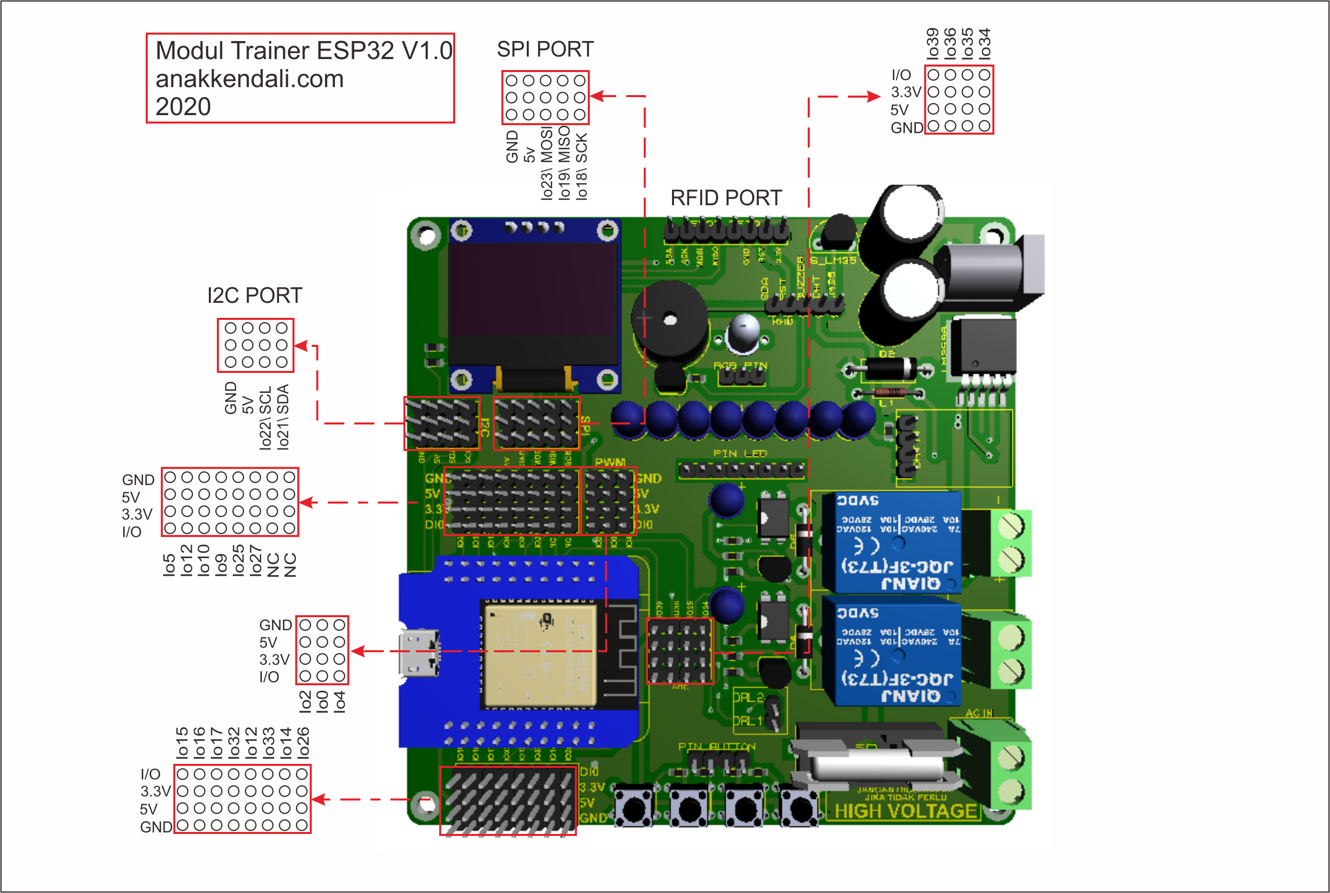
Schematic

